Slide 1
Object- Oriented Programming (CS201)
Lecture 2
Java Basics

Slide 2
Variables
A variable store information such as letters, numbers, words, sentences
A variable has three properties:
A memory location to store the value,
The type of data stored in the memory location, and
The name (identifier) used to refer to the memory location.
Sample variable declarations:
int x; int v, w, y;

Slide 3
Variable declaration and initialization
Variable declaration
int x;
int x,y;
Variable initialization
int x;
x=5;
Variable declaration and initialization
int x=5;

Slide 4
The 8 Java Primitive data types
Numeric data types
example | Number of bytes | Data type
byte x=5; | 1 | Byte
short y=12 | 2 | Short
int x=10; | 4 | Integer
long s=12l; | 8 | Long
float r=1.2f; | 4 | Float
double t=4.7; | 8 | Double
Boolean data type
boolean x=true; boolean y=false; | 1 | Boolean
Character data type
char x=‘a’; | 2 | Character
Notes:
Both primitive values and object references can be converted and cast, so you must consider four general cases:
Conversion of primitives
Casting of primitives
Conversion of object references
Casting of object references

Slide 5
Numeric Operators
When we divide integers, the quotient is also an integer.
14 / 4 is 3, not 3.5

Slide 6
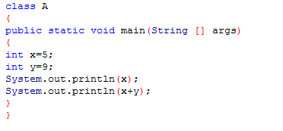

Example

Slide 7

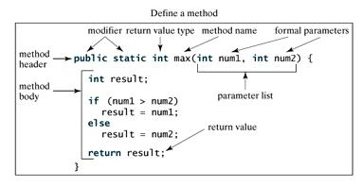
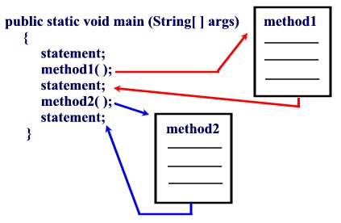
Methods in java
A method is a set of code which is referred to by name and can be called (invoked) at any point in a program simply by utilizing the method's name.

Slide 8
Parts of a method
Modifiers: The modifier, which is optional, tells the compiler how to call the method. This defines the access type of the method.
Return Type: A method may return a value. The returnValueType is the data type of the value the method returns. Some methods perform the desired operations without returning a value. In this case, the returnValueType is the keyword void.
Method Name: This is the actual name of the method. The method name and the parameter list together constitute the method signature.
Parameters: A parameter is like a placeholder. When a method is invoked, you pass a value to the parameter. This value is referred to as actual parameter or argument. The parameter list refers to the type, order, and number of the parameters of a method. Parameters are optional; that is, a method may contain no parameters.
Method Body: The method body contains a collection of statements that define what the method does

Slide 9
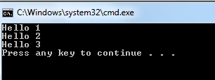
Calling methods in Java
The easiest way to call a method is to declare it as public static
In the same class call the method using its name
In another class , call the method as classname.methodName
class A
{
public static void m1()
{
System.out.println(“Hello 2”);
}
public static void main (String [ ] arg )
{
System.out.println(“Hello 1”);
m1();
System.out.println(“Hello 3”);
}
}
class B
{
public static void main (String [ ] arg )
{
System.out.println(“Hello 1”);
A.m1();
System.out.println(“Hello 3”);
}
}

Slide 10
Declaring constants
Java does not directly support constants. However, a static final variable is effectively a constant.
The static modifier causes the variable to be available without the need to create an object of the class where it is defined.
The final modifier causes the variable to be unchangeable
Java constants are normally declared in ALL CAPS
class Math
{
public static final double PI=3.14;
}

Slide 11
Comments in Java
In Java, comments are preceded:-
by two slashes (//) in a line,
or enclosed between /* and */ in one or multiple lines.
When the compiler sees //, it ignores all text after // in the same line.
When it sees /*, it scans for the next */ and ignores any text between /* and */
// This application program prints Welcome to Java!
/* This application program
prints Welcome to Java!
*/
class A
{
// Author :Ahmed Aly
int x;
public static void m()
{
………..
}
}
class A
{
int x;
public static void m()
{
………..
}
}
Compiler view

Slide 12


Identifier
JAVA use identifiers to name variables, constants, methods, classes, and packages
An identifier is a sequence of characters that consists of letters, digits, underscores (_), and dollar signs ($).
A n identifier cannot start with a digit.
An identifier cannot be a reserved word.
An identifier cannot be true, false, or null.
An identifier can be of any length.
// author: Ahmed Ali
package racing;
public class Car{
String color;
private int speed;
private int numOfDoors=4;
public void incrementSpeed(int value){
…………………..
}
}
$2
ComputeArea
area
radius
showMessageDialog
2A
A-b
d+4
racing, Car, color, speed, numOfDoors, incrementSpeed are all identifiers
Notes:
Since Java is case-sensitive, X and x are different identifiers.

Slide 13

Reserved Words
Reserved words or keywords are words that have a specific meaning to the compiler and cannot be used for other purposes in the program.
For example: class, public, static, and void.
// author: Ahmed Ali
public class Car{
String color;
private int speed;
private int numOfDoors=4;
public void incrementSpeed(int value){
…………………..
}
public void decrementSpeed(int value){
speed=speed-value;
}
public int getSpeed(){
…………………..
}
public boolean isMoving()
{
…………………..
}
public static void getNumberOfCars()
{
}
}
int speed;
int class;
Modifiers
Java uses certain reserved words called modifiers that specify the properties of the data, methods, and classes and how they can be used.
For example: public ,private, final
private int speed;
public static void getNumberOfCars(){ }

Slide 14
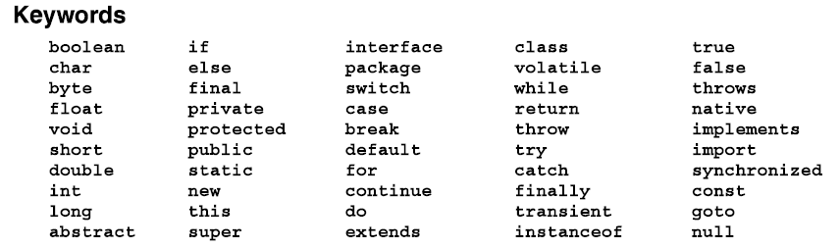
List of Java Keywords

Slide 15


Literal Values for primitives
By default, a numeric literal is either a double or an int,
7
5.6
int
double
float x=4.7;
float x=4.7f;
int x=1342;
double x=1_767.2;
int x=1_342;
byte b = 1;
short s = 2;
Java relaxes its assignment conversion
boolean b = true;
boolean b = True;
boolean v = false;
boolean x = False;
char x=‘A’;
char x=65;
Notes:
This relaxation of the rule applies only when the assigned value is an integral literal.
int i = 12;
byte b = I // compile error

Slide 16
Strings
The data type String hold an array of characters
String values are surrounded by double quotation
String name1=“Ahmed ”;
String name1=new String(“Ahmed ”);
String concatenation is applied using the + operator
String name1=“Ahmed ”;
String name2=“Mohamed”;
String name=name1+name2;
String x=7+” ”;
Combining variables and string
int y=10;
//prints y=10
String s=“y=“+y;

Slide 17
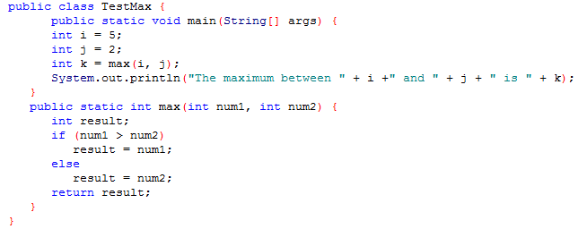

Example

Slide 18
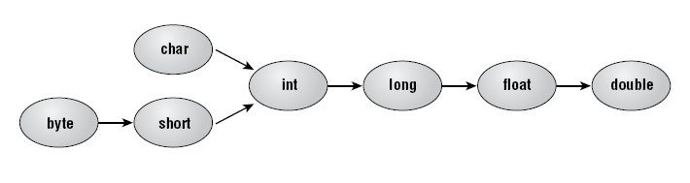
Primitive data type conversion
A primitive data type can be converted to another type, provided the conversion is a widening conversion
1-Conversion by Assignment
3-Conversion by Arithmatic Promotion
int i=12;
double d=i;
All operands are set to the wider type of them
The promotion should be to at least int
short s1=7;
short s2=13;
// short s3=s1+s2; compile error as s1,s2 are converted to int
int i=s1+s2;
2-Conversion by Method call
class test{
void m1(){
int i=9;
m2(i);
}
void m2(double d){
///
}
}

Slide 19

Primitive Casting
Casting is explicitly telling Java to make a conversion.
A casting operation may widen or narrow its argument.
To cast, just precede a value with the parenthesized name of the desired type.
double d = 4.5;
int i=12;
int i = d;
short s=i;
short s=(short)i;
int i = (int)d;
short i=7;
i=i +3;
int i=4 +7.0;
int i;
short s=(short) (i +3);
int i=(int) (4 +7.0);

Slide 20
Java Operators
Arithmetic
+,-,*,/,%,++,--
Logic
&,|,~,&&,||
Assignment
=, +=, -=, etc..
Comparison
<,<=,>,>=,==,!=
Work just like in C/C++,
Notes:
Logic
&,|,^,~,<<,>>,>>>

Slide 21
Control Structures
The for loop is similar to C/C++
Java also has support for continue and break keywords
Again, work very similar to C/C++
for(int i = 0; i < 10; i++) {
a += i;
if(a > 100)
break;
}
for(int i = 0; i < 10; i++) {
if(i == 5)
continue;
a += i;
}

Slide 22
Control Structures
if/else, for, while, do/while, switch
Basically work the same as in C/C++
i = 0;
while(i < 10) {
a += i;
i++;
}
for(i = 0; i < 10; i++) {
a += i;
}
if(a > 3) {
a = 3;
}
else {
a = 0;
}
switch(i) {
case 1:
string = “foo”;
case 2:
string = “bar”;
default:
string = “”;
}
i = 0;
do {
a += i;
i++;
} while(i < 10);

Slide 23
3 Type of Errors might be in your program
i-Compile Errors
Compile errors occurs on attempting to compile your file
Compile errors prevent the creation of the .class file
Compile error occurs when a syntax rule is not obeyed
ii-Runtime Errors
Runtime errors occurs after the program has compiled successfully and is running
Runtime error in java are called Exceptions
Exceptions can occur for many reasons including a wrong input from user or a certain resource (eg. A file) that was not found.
iii-Logic Error
The class compiled and run without reporting any errors
The task is not executed correctly due to algorithmic error

Slide 24
Brief Introduction to objects and classes
We work with physical objects all the time: televisions, cars, customers, reports, light bulbs,printers.
A software object is a representation of a thing that we want to manipulate in our program.
A class is a template that defines what an object's data and methods will be.
objects share two characteristics: state and behavior.
The state of an object is represented by variables and behavior by a set of methods
OOP reflects how people think of real world.
class Student
{
String name;
double GPA;
int registerationNumber;
…………………..
void registerUnit()
{
…………………
}
void payFees(){……}
}
class Circle
{
double radius;
…………………..
double getArea()
{
…………………
}
…………………….
}
class className
{
}
Variables describing state
Methods describing behavior
Student object 1
Student object 2
name =Ahmed Aly
registration number=245245
GPA=3.2
name =Mohamed Fathi
registration number=34345
GPA=2.2
register a unit
payFees

Slide 25
A Simple Java class
// author: Ahmed Ali
package racing;
public class Car{
String color;
private int speed;
private int numOfDoors=4;
public void incrementSpeed(int value){
…………………..
}
public void decrementSpeed(int value){
…………..
}
public int getSpeed(){
…………………..
}
public boolean isMoving()
{
…………………..
}
public static void getNumberOfCars()
{…………………
}
}

Slide 26
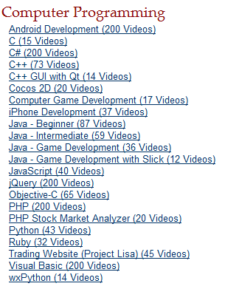
Useful Links
http://thenewboston.org/tutorials.php

